Slide 1

South Eastern Community Connect
https://www.secc.sydney/

Slide 2
Application development team
Group :

Slide 3
INTRODUCTION TO South eastern community connect (SECC)
COMPANY: Southern Eastern Community Connect
PROJECT: Develop Mobile Application of SECC
ORGANIZATION: This organization began in 1987. It is a non-profit organization that supports people with a broad range of financial and emotional help.
AIM: To create a mobile application, provide a platform for providing volunteer services to the general public., establish a contribution platform, through the platform, to assist those in need, make charitable work feasible, educate some members of the millennial generation and optional contributions for individuals who want to donate in their own unique way.

Slide 4
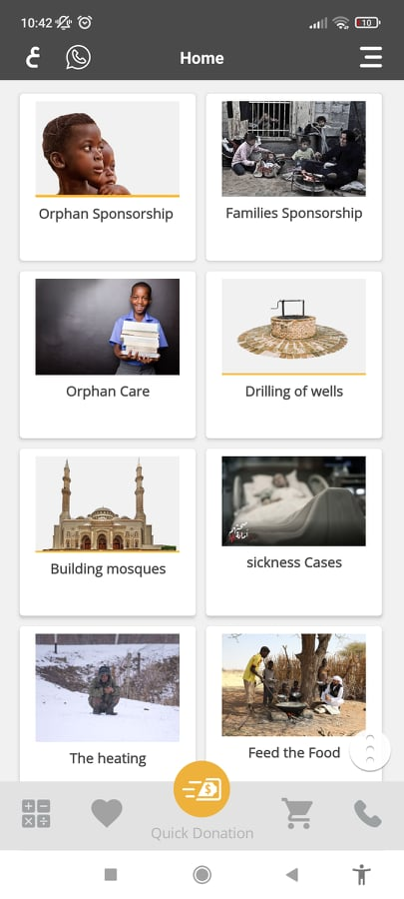
LITERATURE REVIEW
Research on similar Apps
International Charity ORGANIZATION APP- Features
Donation
Orphan care
Sponsorships
Food for needy
Sickness care etc.

Slide 5
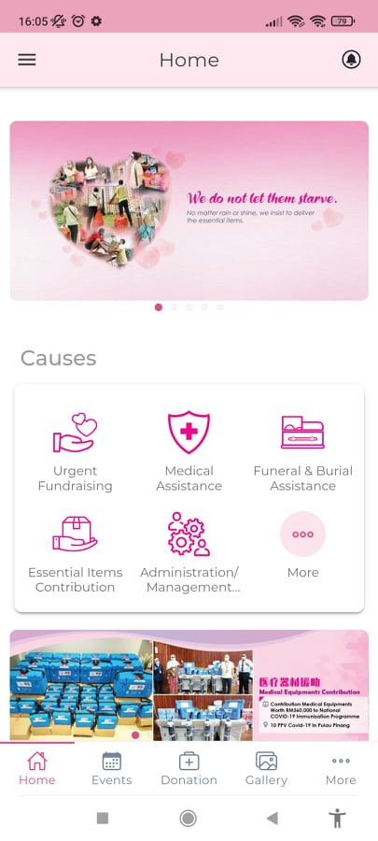
LITERATURE REVIEW
Research on similar Apps
One Hope Charity & Welfare APP- Features
Fund Raising
Medical Assistance
Essential Items Contribution
Events
Gallery

Slide 6
LITERATURE REVIEW
Application Architecture
There really are two components to every application: the front-end and the back-end. The front-end, often abbreviated also as client hand, does what a user sees & communicates with it while using a web browser. The main objective of the client end would be to acquire information from customers.
Android Studio
Visual Studio Code
Flutter Dart
Node js
MySQL
Credit Card API
PayPal API
Xampp

Slide 7
DOMINATING APPLICATION DEVELOPMENT FRAMEWORK
Android studio: Android Studio is a comprehensive development kit for producing Android mobile apps, tablets, Wear Os, Android TV, and Android Auto.
Visual studio code: Visual Studio Code claims to be a minimalist code editor with validation, executing, and version management software.
Flutter Dart: Flutter purports to be a Google-created SDK enabling providing interactive user interfaces. It leverages the Dart programming language to facilitate the development of iOS/Android programs.
Node js: Node. Js is especially applicable for the creation of such applications with a high number of consecutive linkages because the events looping is suspended during the operation of a function, so each request just needs a few CPU cycles.
Mysql: MySQL is an absolutely free database management system (RDBMS). It keeps costs down during the production of this application.
Credit card API: You can develop interesting payment processes in native Android and iOS apps using the Flutter SDK. As a conclusion, the credit card API is constructed using the Flutter SDK.
Paypal API: Paypal will be integrated as the payment gateway for the donation in SECC mobile application.
Xampp: XAMPP means for cross-platform application programming interface. On the server side, this permits you to generate an offline webpage.

Slide 8
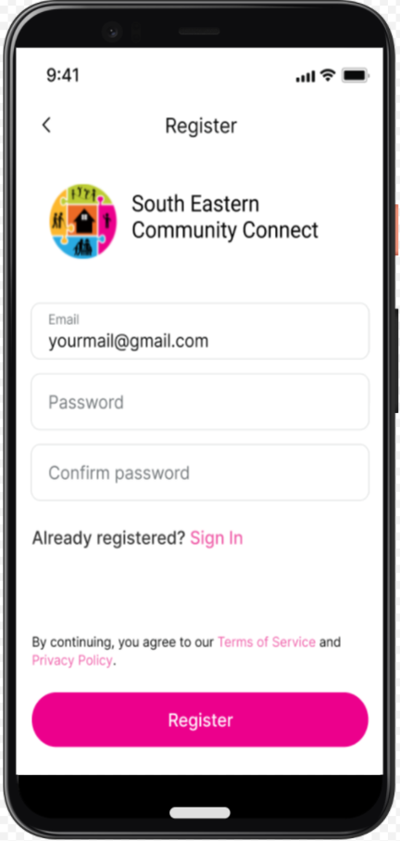
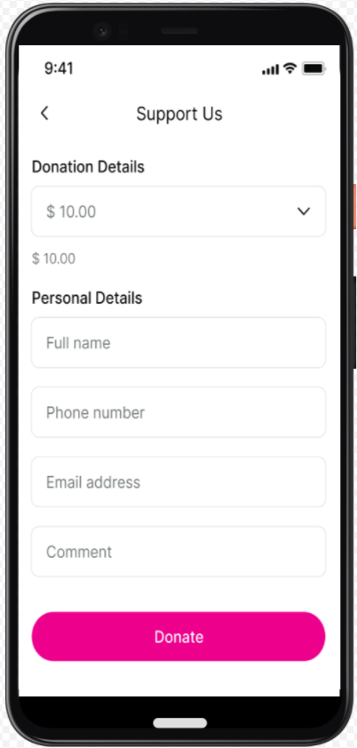
Functional Requirements
The following are the project's functional requirements:
Register and Login
Donate
Access donation history
Access news
Access about
Access resources
Get emotional help

Slide 9
Non-Functional Requirements
Here below are the required non-functional requirements of the SECC mobile app:
Scalability
Usability
Security Requirement
Recoverability
Data Integrity
Feasibility
Manageability
Reliability
Accessibility
Performance

Slide 10
LIMITATIONS
Some of the limitations followed with the development of the SECC mobile app project are as follows:
The organization is reliant on government funds, and in order to finance its volunteer program, they must conduct a contribution program.
The client wanted to use a calendar plus ticketing system, something we had never done previously.
Chatbot can be added however, simple messaging and email and phone will be used for the communication for now in the app.

Slide 11
WBS
User Friendly
MAIN PLAN
Gantt Chart
PLANNING
Backup/Recovery
Milestone

Slide 12
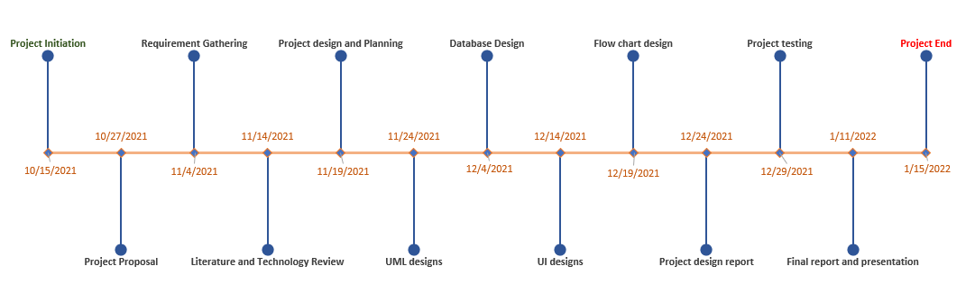
MILESTONES
The milestones includes planning and progress of development of this project

Slide 13
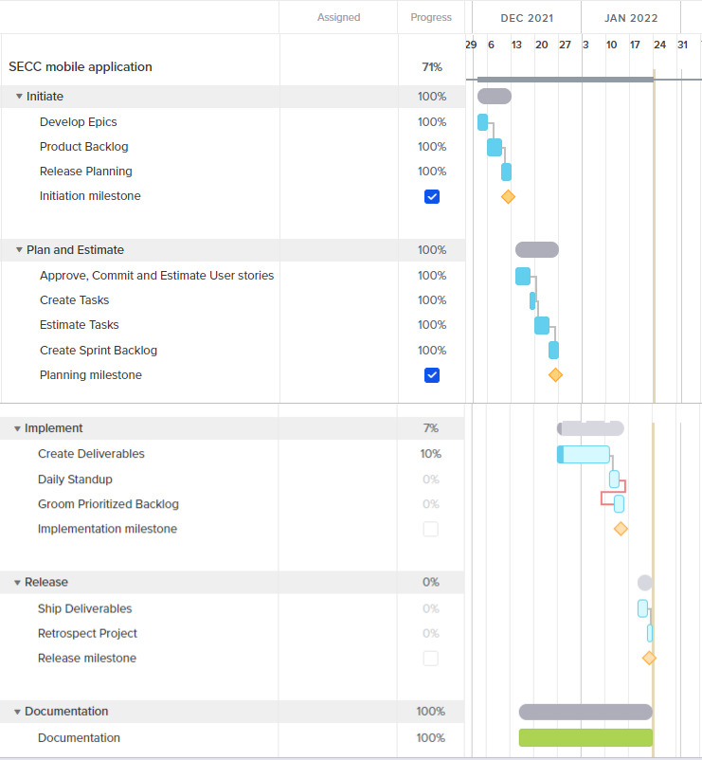
Gantt CHART
The given gantt chart shows the date for every task and creates milestones for the completion of every task. The gantt chart has been made according to the Agile methodology. Hence, the part of the milestones all are included within the two phases of the agile project management.

Slide 14
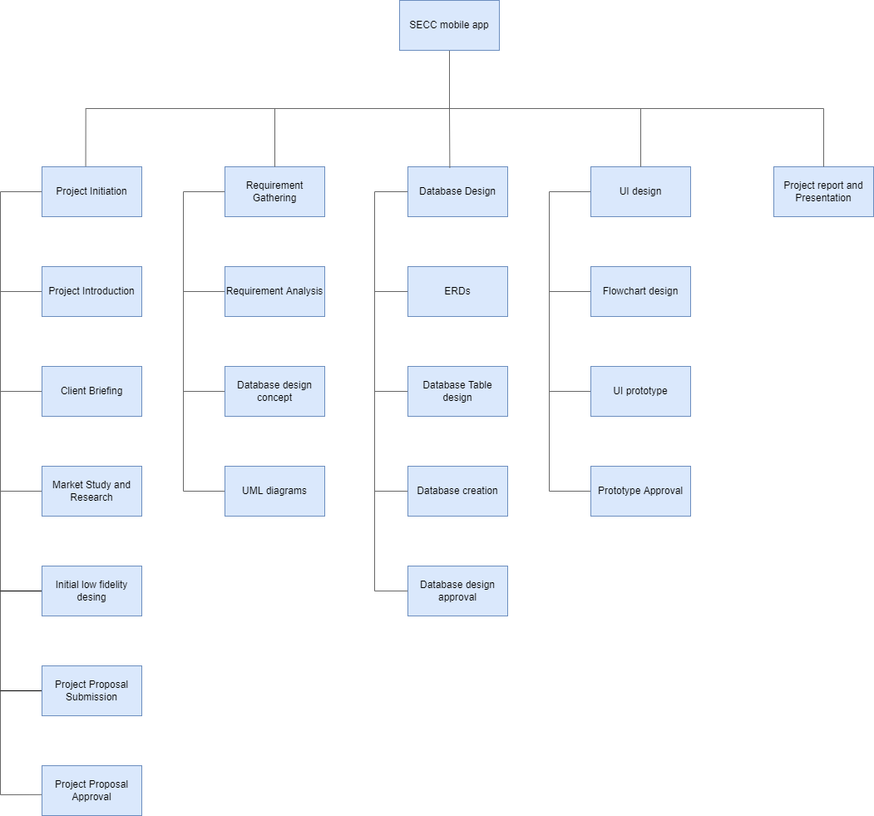
WORK BREAKDOWN STRUCTURE

Slide 15
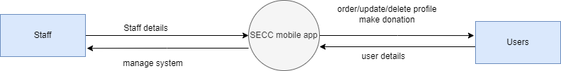
CONTEXT-LEVEL DESIGN

Slide 16
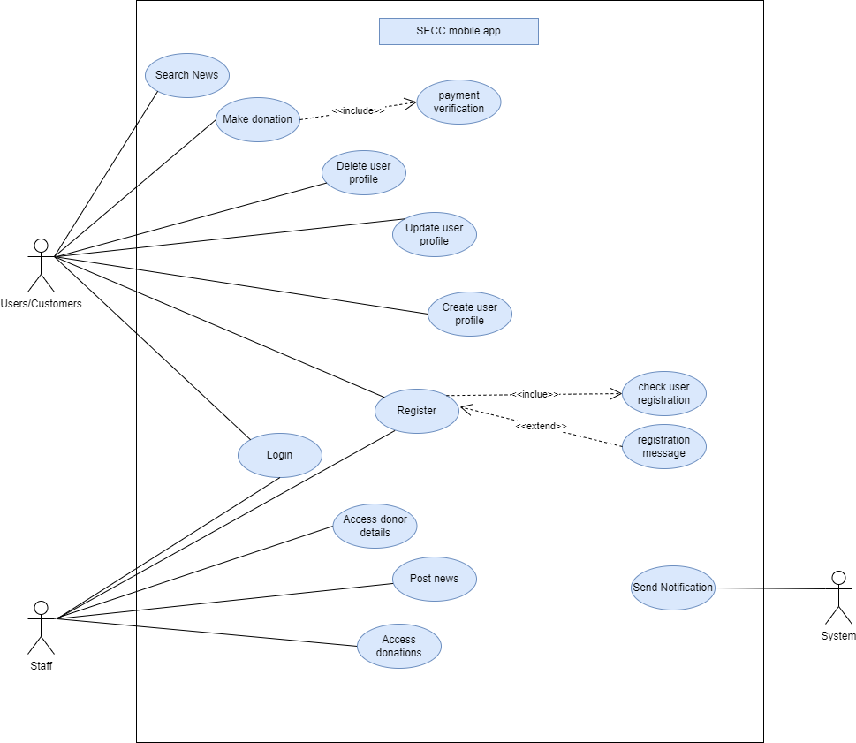
USE CASE DIAGRAM

Slide 17
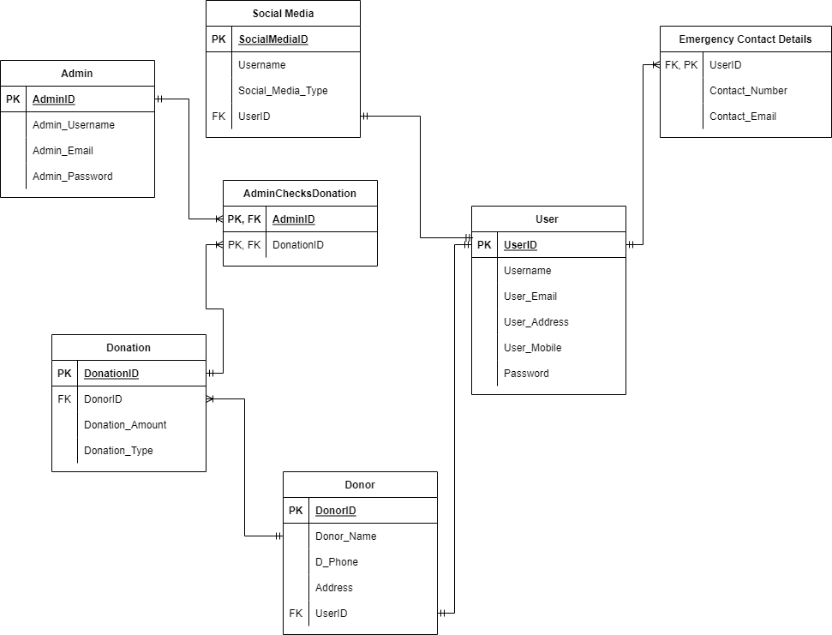
ENTITY-RELATIONSHIP DIAGRAM

Slide 18
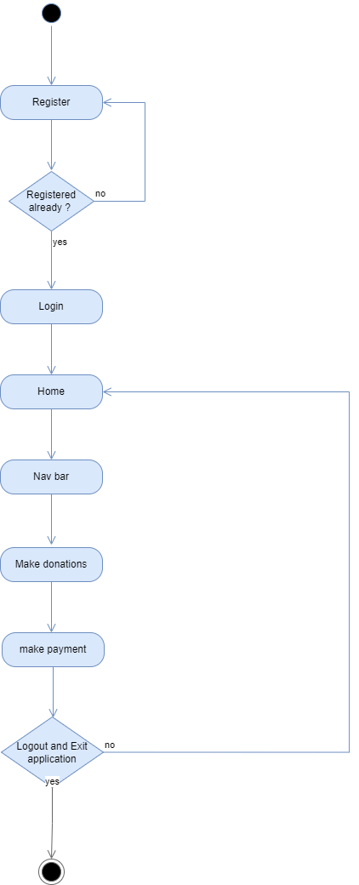
ACTIVITY DIAGRAM

Slide 19
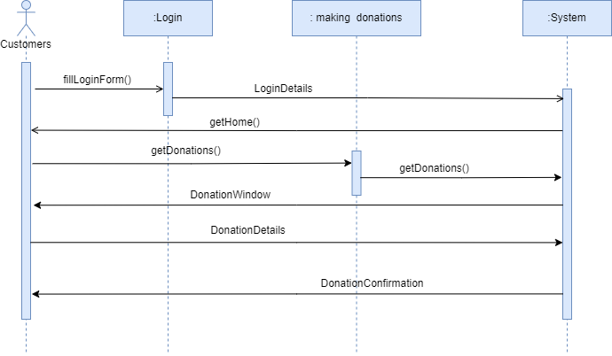
SEQUENCE DIAGRAM

Slide 20
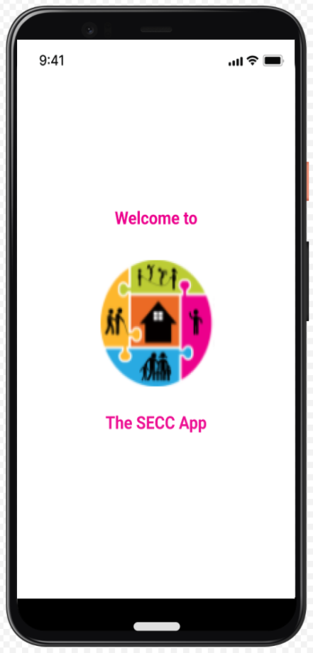
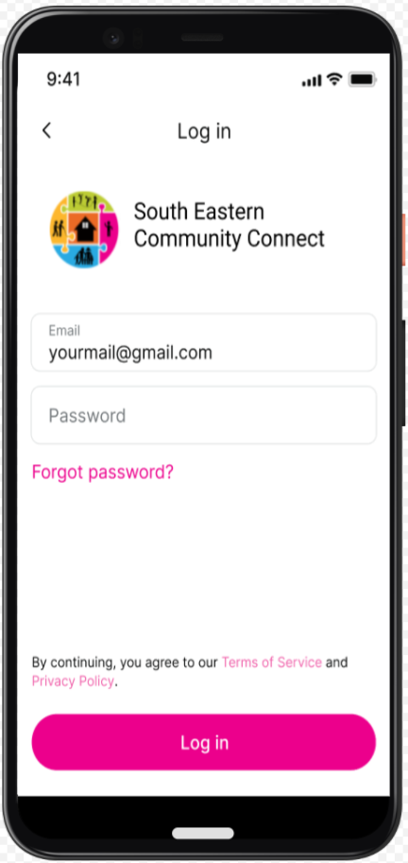
INTERFACE DESIGN

Slide 21
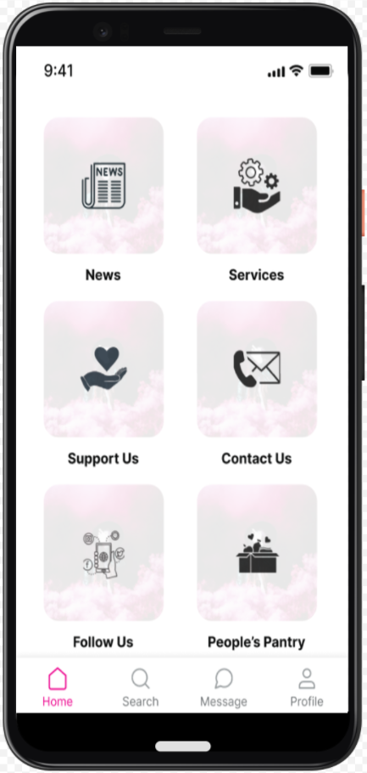
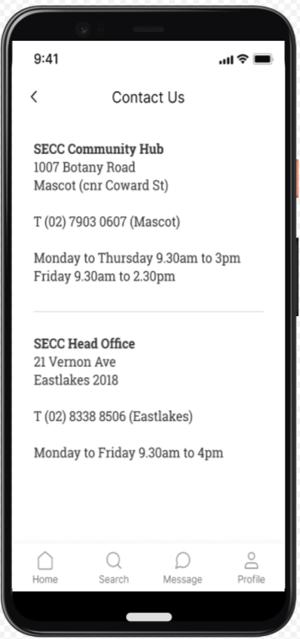
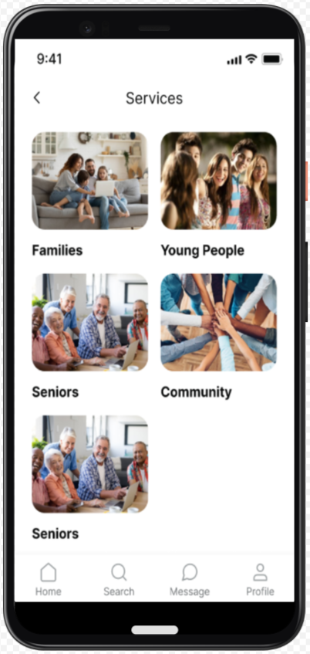
INTERFACE DESIGN

Slide 22
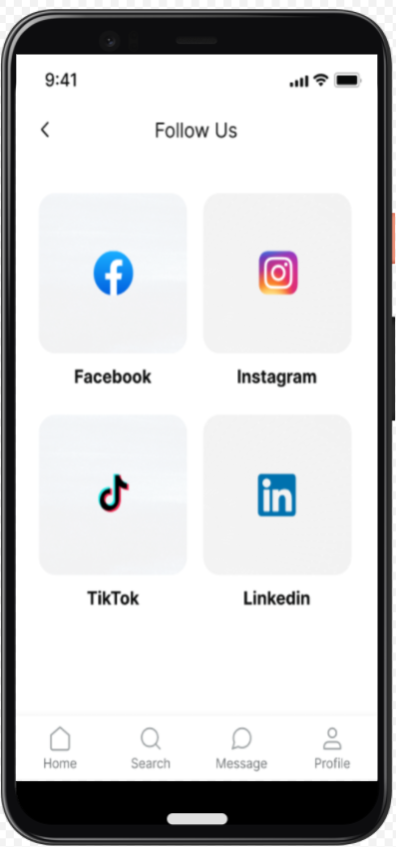
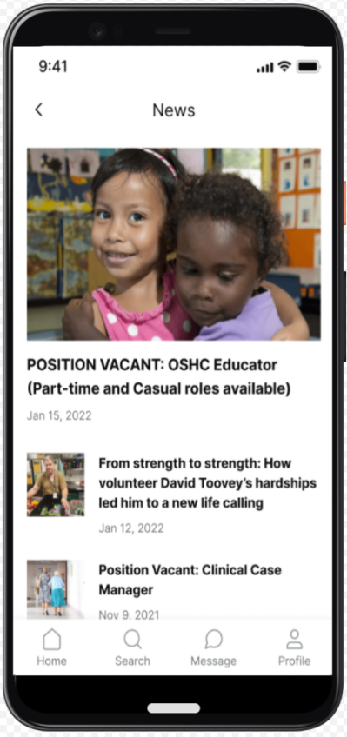
INTERFACE DESIGN

Slide 23
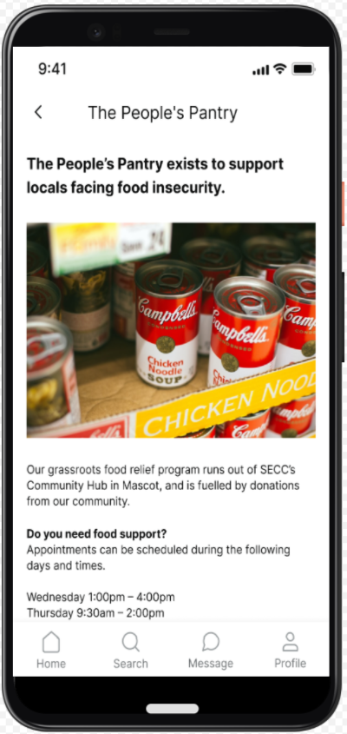
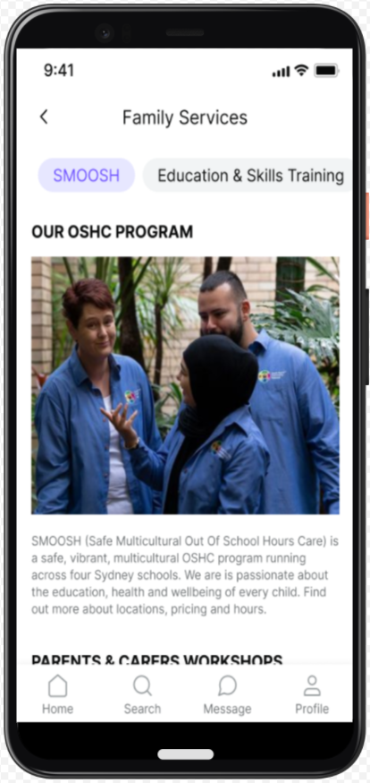
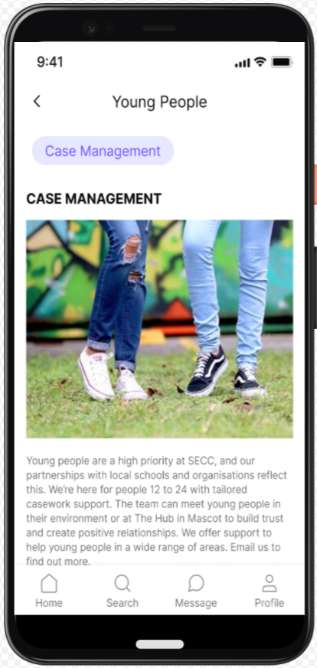
INTERFACE DESIGN

Slide 24
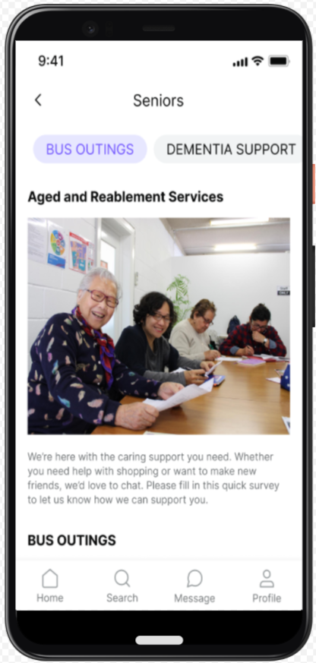
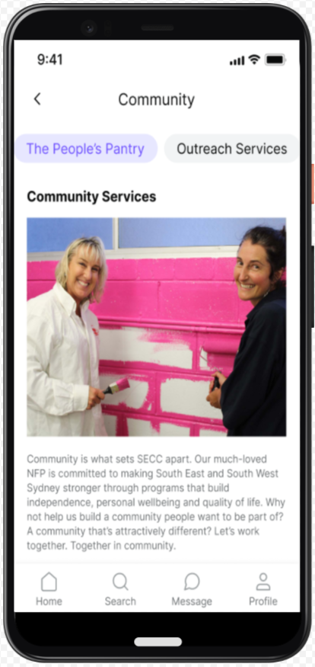
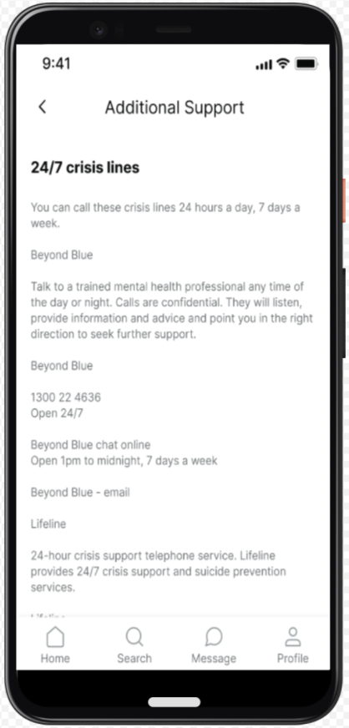
INTERFACE DESIGN

Slide 25
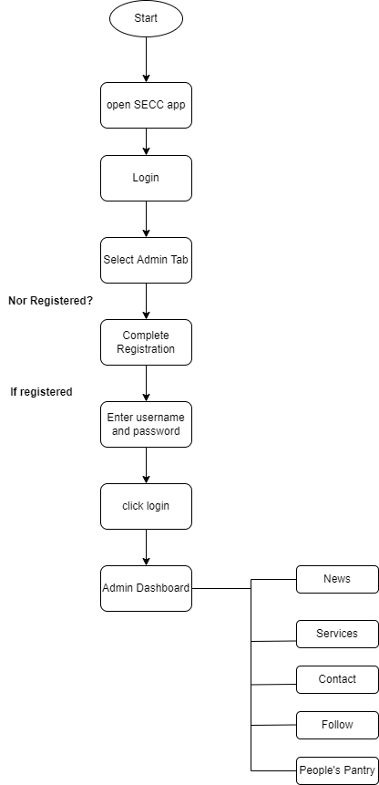
Admin Flowchart

Slide 26
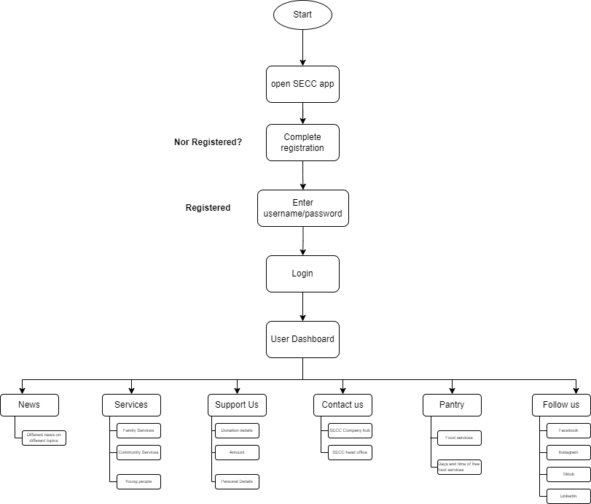
User Flowchart

Slide 27
CONCLUSION AND FUTURE PLAN
The built mobile application will serve as the learning platform for youths, communicating platform for every individual and a sustaining platform for all the needy.
With the help of the application many unheard will be heard, many who wish to help and do philanthropic work will have an opportunity to do so.
Furthermore, the application will be deployed in the playstore and the Appstore as well. In the following years, the organization will concentrate solely on software functionality.
The primary objective is to guarantee that the application fits the users' needs.
Apparently, after all the designs and diagrams, it can actually make the a fully fledged charity mobile application.

Slide 28
THANK YOU!!!!

